Slide 1
Introduction
National income is the single most important macro variable as it gives measure of the ‘economy as a whole’.
The level of national income determines the level of all other macroeconomic variables—aggregate consumption, savings and investment, employment and the price level.
The importance of national income accounting lies in the fact that the performance and behaviour of an economy are studied on the basis of the performance of its macroeconomic variables.

Slide 2
National Income
In general sense of the term, national income refers to the aggregate money value of all final goods and services resulting from the economic activities of the people of a country over a period of one year.

Slide 3
Basic Concepts Related to National Income
Economic vs Non Economic Production
Intermediate vs final goods
Transfer payments
Consumer vs Producer Goods

Slide 4
Measures of National Income:
Gross Domestic Product (GDP)
Gross National Product (GNP)
Net National Product
Personal Income & Disposable Income

Slide 5
Gross Domestic Product (GDP)
The Gross Domestic Product (GDP) can be defined as the sum of market value of all final goods and services produced in a country during a specific period of time, generally one year.
It includes income earned by the foreigners in the country and excludes income earned abroad by the residents.
The market value of domestic product is obtained at both constant and current prices.

Slide 6
Gross National Product (GNP)
The concept of GNP includes the income of the resident nationals which they receive abroad, and excludes the incomes generated locally but accruing to the non-nationals.
GNP = Market value of domestically produced goods and services
plus incomes earned by the residents of a country in foreign countries minus incomes earned by the foreigners in the country.
GDP = Market value of goods and services produced by the residents in the country
plus incomes earned in the country by the foreigners
minus incomes received by residents of a country from abroad.

Slide 7
Net National Product (NNP)
The NNP is the measure of national income which is available for consumption and net investment to the society.
NNP = GNP- Depreciation of capital
It the actual measure of national income.
The NNP divided by the population of the country gives the per capita income.

Slide 8

Personal Income (PI)
Personal income (PI) can be defined as the sum of all kinds of incomes received by the individuals from all sources of incomes.
The sum of personal incomes is not exactly the same as NNP.
(where UDP = undistributed company profits; SPU = surplus of public undertakings; RPP = rentals of public properties and PI excludes items not included in NNP)

Slide 9
Disposable Income and Private Income
Disposable income- It refers to personal income of the income earners against which they do not have any legally enforceable payment obligations.
Private income-Broadly, all personal incomes are private incomes. However, the term private income is used in contrast to public income.

Slide 10
Nominal and Real GNP
The GNP estimated at current prices is called nominal GNP and GNP estimated at constant prices in a chosen year is called real income.
Real GNP gives national income estimates free from distortion caused by inflation or deflation.

Slide 11

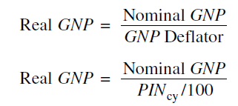
The GNP Deflator
The GNP deflator is essentially an adjustment factor used to convert nominal GNP into real GNP.
The formula for converting nominal GNP of a year into real GNP
cy = Chosen year
Or,

Slide 12

GNP Implicit Deflator
GNP implicit deflator is the ratio of nominal GNP to real GNP.
The GNP implicit deflator can be used for:
To construct price index number, and
To measure the rate of change in prices

Slide 13
Methods of Measuring National Income
Net Product Method or the Value Added Method
Factor Income Method, and
Expenditure Method

Slide 14
Net Product Method
This method consists of three stages-
Estimating the gross value of domestic output in the various branches of production;
Determining the cost of material and services used and also the depreciation of physical assets; and
Deducting these costs and depreciation from gross value to obtain the net value of domestic output.

Slide 15
Value Added Method
In the net product method, the problem of double counting is often confronted. Value added method is used to avoid double counting.
For estimating value added-
Identifying the production units and classifying them under different industrial activities.
Estimating net value added by each production unit in each industrial sector.
Adding up the total value added of each final product to arrive at GDP.

Slide 16
Factor Income Method
In this method, the national income is treated to be equal to all the “incomes accruing to the basic factors of production used in producing the national products.”
In modern economy, the national income is considered to be comprised of three components:
Labour incomes,
Capital incomes, and
Mixed incomes.

Slide 17
Expenditure Method
Under expenditure method, also known as the final product method, national income is measured as sum of the final expenditure stage.
In order to estimate the aggregate expenditure, any of the following two methods may be followed:
Income Disposal Method
Product Disposal Method

Slide 18
Treatment of Net Income from Abroad
In estimating the national income, net incomes from abroad are added to GDP and net losses are subtracted from GDP to arrive at the national income figure of an open economy.
GDP adjusted for net income from abroad is called Gross National Income (GNI).

Slide 19
Double Entry System of Accounting
A double entry accounting system is one in which both receipts and payments are recorded. Receipts are treated as credit items and payments as the debit items in national income accounting.
Another aspect of the double accounting system is that the account of a person need not be in balance.
In this system, many types of accounts can be imagined and operated.

Slide 20
Double Entry System of Accounting (Contd.)
In national income accounting of double accounting system, the main types of transactions and their accounting include the following:
Private Consumption,
Government consumption,
Investment (savings converted into capital),
Government taxes and spending,
Inventories, and
Net of foreign transactions (exports and imports).

Slide 21
History of National Income Measurement in India
In the pre-independence phase, the first attempt ever to measure national income of India was made by Dadabhai Naoroji in 1867-68.
The first systematic attempt to estimate India’s national income was made by Prof. V.K.R.V. Rao for the year 1925-29 and again for the year 1931-32.
In the post-independence phase, the first official estimate of India’s national income was made in 1949 by the Ministry of Commerce, Government of India.
Since 1967, the task of estimating national income has been assigned to the Central Statistical Organisation (CSO).

Slide 22
Sectoral Classification of Economy for Measuring National Income
Primary sector, including agriculture and allied activities, forestry, fishing, mining and quarrying;
Secondary sector, including manufacturing industries, and
Tertiary sector or service sector, including banking, insurance, transport and communication, trade and commerce.

Slide 23
Methods of Measuring National Income in India
(i) Production Method is used to estimate income or domestic product of the following production sectors:
1. Agricultural and allied services
2. Forestry and logging
3. Fishing
4. Mining and Quarrying
5. Registered manufacturing

Slide 24
Methods of Measuring National Income (Contd.)
(ii) Income method is used for estimating domestic income of the following sectors:
Unregistered manufacturing,
Gas, electricity and water supply,
Banking and insurance,
Transportation, communication and storage,
Real estate, ownership of dwellings and business services,
Trade, hotels and restaurants,
Public administration and defense,
Other services.

Slide 25
Methods of Measuring National Income (Contd.)
In India, as per expenditure method, the sectoral accounting of GDP, follows the following classification of the national income:
Private final consumption expenditure including expenditure.
Government final consumption expenditure
Gross fixed capital formation including construction, machinery and equipments,
Change in stocks, and
Net export of goods and services.

Slide 26
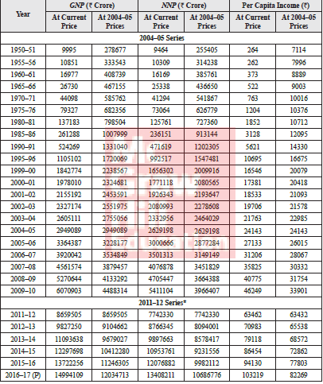
Estimates of India’s GNP, NNP and Per Capita Income at Factor Cost
Notes:
Table has been updated till 2016-17

Slide 27
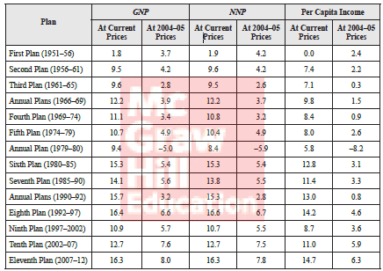
Annual Growth Rate of India’s GNP, NNP and Per Capita NNP (At Factor Cost)

Slide 28
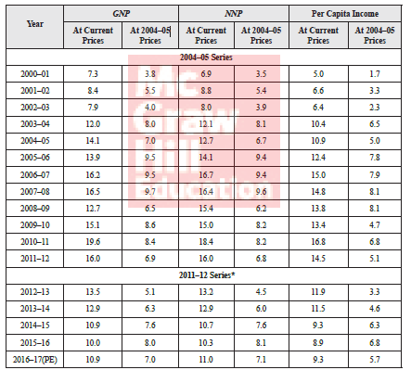
Annual Growth Rate (%) of India’s GNP, NNP and Per Capita NNP-2000-01 to 2010-11
(All at Factor Cost)

Slide 29
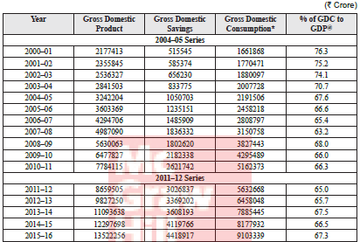
GDP, Aggregate Savings and Consumption in India: 2000–01 to 2016–17
(All at current prices)

Slide 30
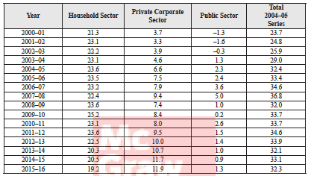
Percentage of Gross Domestic Savings to GDP in India 2000–01 to 2016–17 (Percentage to GDP at current prices)

Slide 31
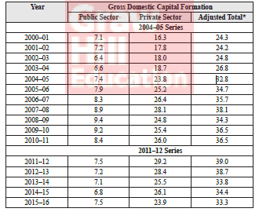
Percentage of Gross Domestic Capital Formation to GDP (GDP at current prices)

